Slide 1
Tree, Hashing
Santosh Kumar Verma
Mentor@GeeksforGeeks

Slide 2


Tree Data Structures
Tree data structures are versatile and powerful ways to organize and manipulate hierarchical information. In this presentation, we'll explore their many applications and learn how to use them effectively.

Slide 3
Definition and Characteristics of Trees
1
Node-Based Structure 🌳
2
Hierarchical Relationship
A tree is a collection of nodes connected by edges, with a single root node and no cycles or loops.
Trees represent a natural hierarchical structure, making them ideal for organizing data that has parent-child relationships.
3
Multiple Branches 🌱
4
Recursive Nature
A tree can have multiple branches, with each node having at most one parent and zero or more children.
The recursive structure of trees allows for efficient algorithms with logarithmic time complexity.

Slide 4
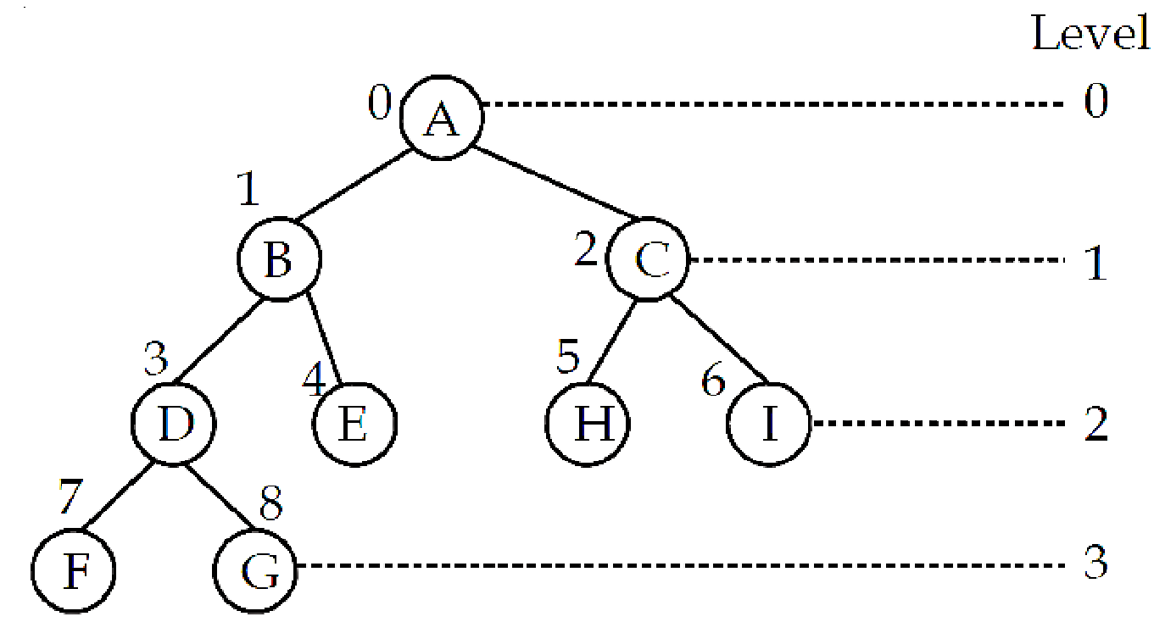
Binary Tree
A tree is a non-linear data structure. It is considered as a powerful and very flexible data structure that can be used for a wide variety of applications.
Root: Root is the first node of the hierarchical data structure. It is present at the 0th level and this node represents the base address of the tree. As node A is the root of the tree.
Nodes: Each data item in the tree is called a node like a node in a graph. It specifies the information about the data and the links to other items. A, B, C, D, E, and F are the nodes of the tree.
Degree: The number of nodes connected to a particular node ‘A’ is called the degree of that node ‘A’. The degree of the leaf node is always one. As deg(A)=2, deg(B)= deg(C)= deg(D)=3, deg(E)= deg(H)=1,
The degree of the tree is the maximum value of the degree of any node in the tree. As deg(tree) =3.
Level: The root node of the tree has level 0. The level of any other node is one more than the level of its parent. As Level(A)=0, Level(B)=Level(C)=1 and so on.
Depth: The maximum level of any leaf is called the depth of the binary tree. As the depth of the tree would be 3 here. Root is at depth 0.

Slide 5
Height: Height of the tree is the total number of edges from the root node to the terminal/leaf node on a longest path. As Height of the tree would be 3 here. A leaf node has a height of 0.
Ancestor: A node “A” is said to be an ancestor of node “B” if A is either the father of B or the father of some ancestor of B.
For example; A is an ancestor of B, E, etc.
Descendent: A node “B” is said to be a left descendant of node “A” if B is either the left son of A or the descendant of the left son of A.
For example; G, F, D, B, E are the left descendent to node A.
A node “B” is said to be a right descendant of node “A” if B is either the right son of A or the descendant of the right son of A.
For example; C, H, I are the right descendent of node A.
Climbing: Is the process of traversing the tree from the leaf node to the root node, also known as Bottom-up traversal.
Descending: Is the process of traversing the tree from the root node to the leaf node, also known as Top-down traversal.

Slide 6
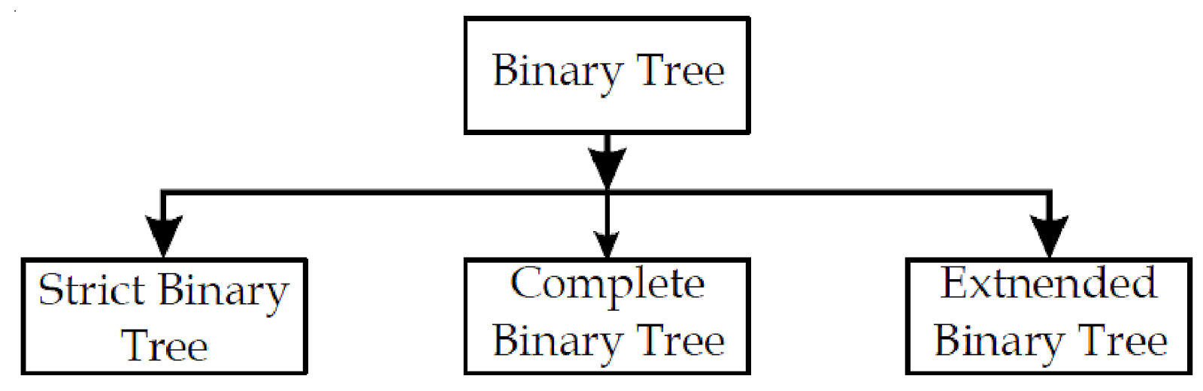
TYPES OF BINARY TREES
Full Binary Tree: A binary tree in which every node other than the leaves has two children.
Complete Binary Tree: A binary tree in which all levels, except possibly the last, are completely filled, and all nodes are as far left as possible.
Perfect Binary Tree: A binary tree in which all interior nodes have two children, and all leaves are at the same level.

Slide 7
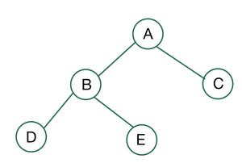
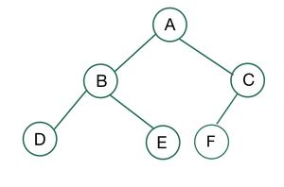
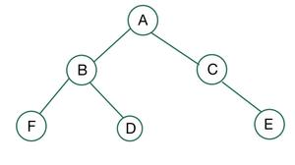
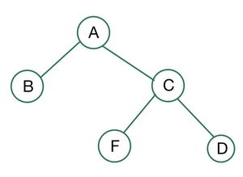
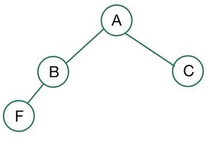

Slide 8
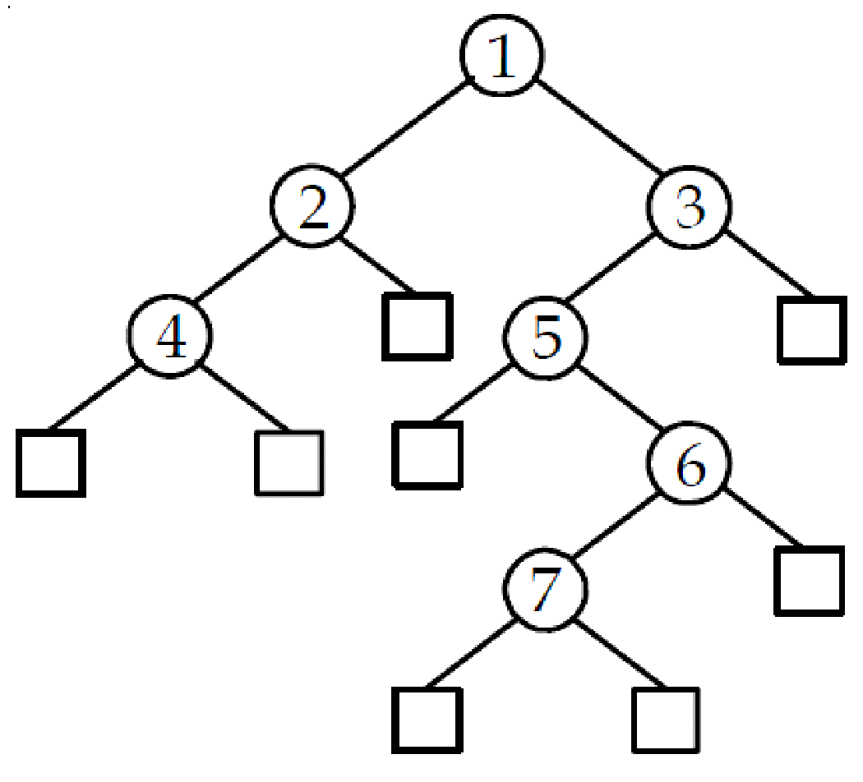
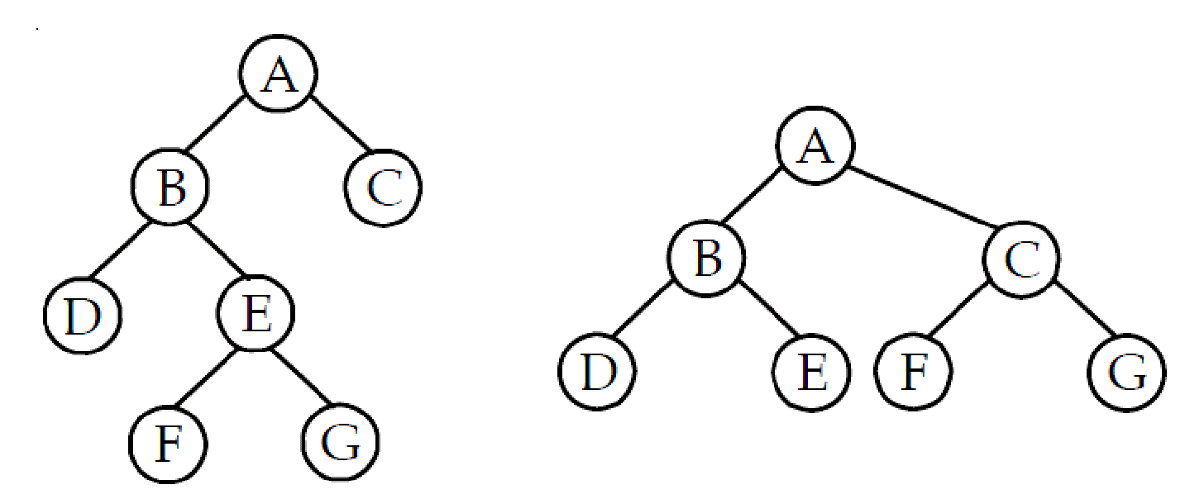

Slide 9
S. No. | Complete Binary Tree | Full Binary Tree
1. | In a complete binary tree, a node in the last level can have only one child. | In a full binary tree, a node cannot have just one child.
2. | In a complete binary tree, the node should be filled from the left to right. | There is no order of filling nodes in a full binary tree.
3. | Complete binary trees are mainly used in heap-based data structures. | Full binary tree has no application as such but is also called a proper binary tree.
4. | A complete binary tree is also called almost complete binary tree. | A full binary tree also called proper binary tree or 2-tree.
5 | A complete binary tree must have the entire leaves node in the exact same depth. | In full binary tree leaf level not necessarily have to be in the same depth.

Slide 10
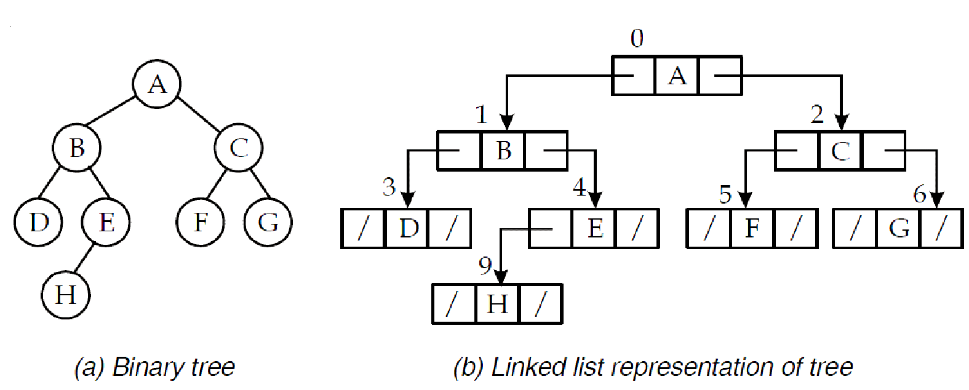
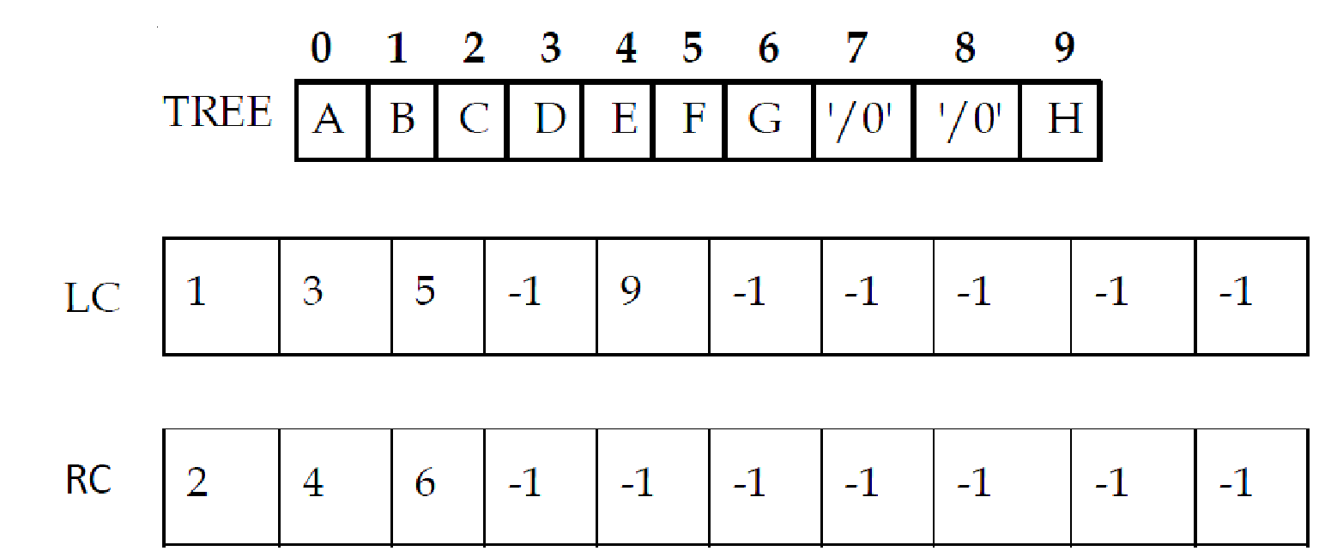
REPRESENTATION OF BINARY TREE IN MEMORY

Slide 11
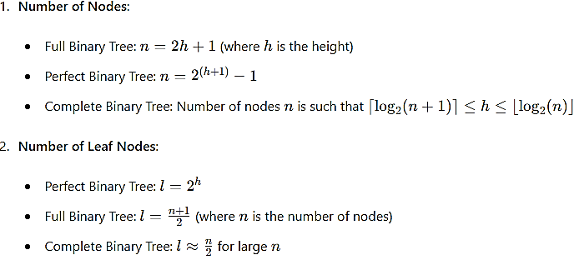
Key Properties and Formulas:

Slide 12
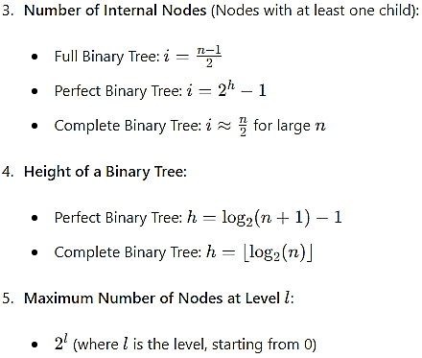
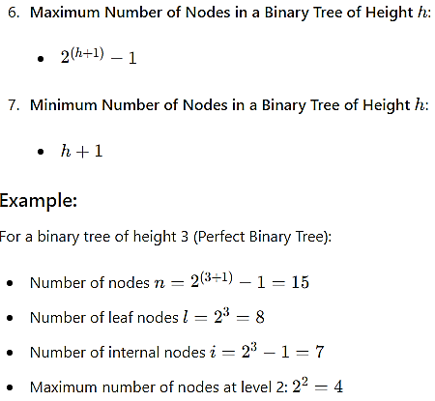
Key Properties and Formulas:

Slide 13

Operations on Trees
1
Traversing and Searching 🔍
There are multiple ways to traverse a tree, such as Inorder, Preorder, Postorder and Level-Order. Searching can be done recursively or iteratively, depending on the tree's structure.
Insertion and Deletion ➕ ➖
2
New nodes can be inserted into a tree in an ordered manner, while existing nodes can be deleted using their position or value. These actions are crucial for sorting and manipulating hierarchical data.

Slide 14
INSERTION & DELETION in BINARY TREE

Slide 15
TRAVERSING BINARY TREE
Pre-order: N-L-R (node(root)-left-right)
In-order: L-N-R (left-node(root)-right)
Post-order: L-R-N (left-right-node(root))

Slide 16
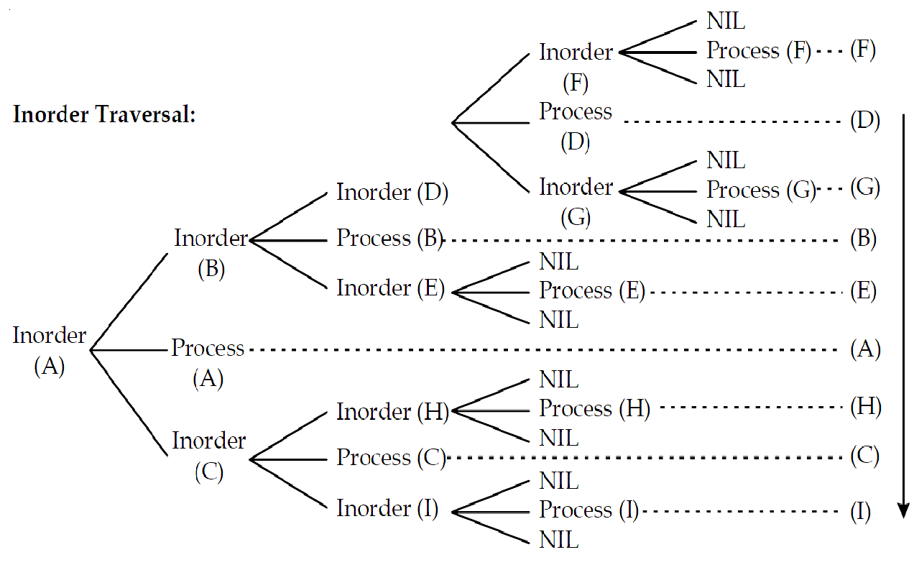
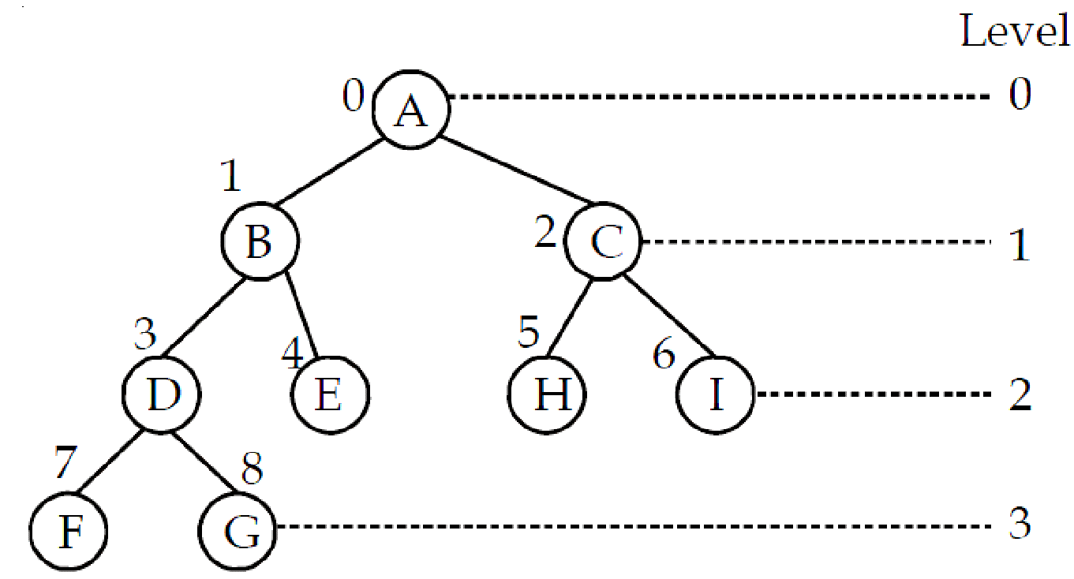

Slide 17
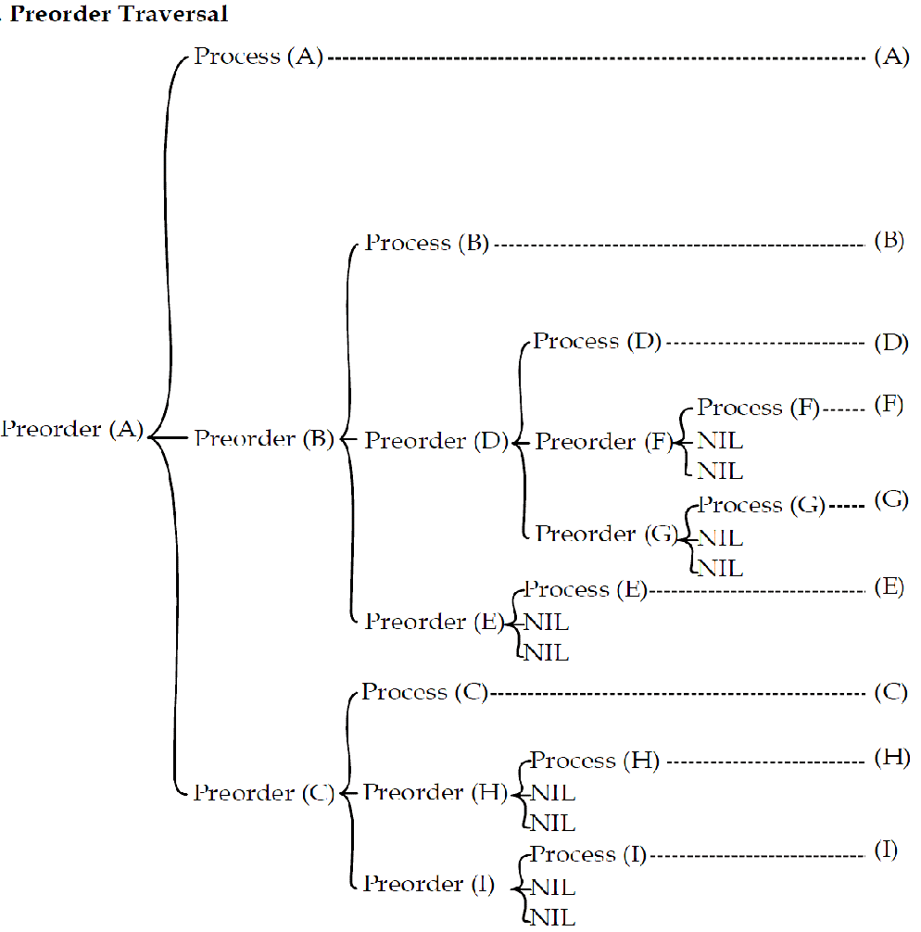

Slide 18
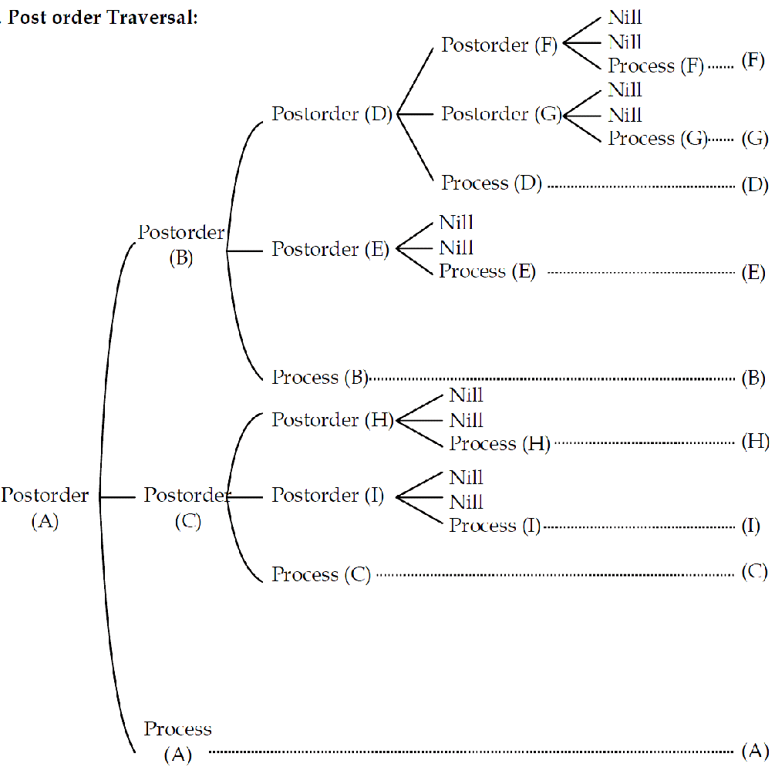

Slide 19
Reconstructing Binary Tree from Traversals
Pre-order : [A,B,D,E,C,F,G]
In-order : [D,B,E,A,F,C,G]
Post-order : [D,E,B,F,G,C,A]

Slide 20
Reconstructing Binary Tree from Traversals
Pre-order : [A,B,D,E,C,F,G]
In-order : [D,B,E,A,F,C,G]
Post-order : [D,E,B,F,G,C,A]

Slide 21
Reconstructing Binary Tree from Traversals
Pre-order : [A,B,D,E,C,F,G]
In-order : [D,B,E,A,F,C,G]
Post-order : [D,E,B,F,G,C,A]

Slide 22
Applications of Tree Data Structures
File Systems and Directory Structures 📁
Representing Hierarchical Relationships 👨‍👩‍👧‍👦
Sorting and Searching Algorithms 🕵️‍♂️
Trees are a natural way to represent the filesystem hierarchy and the folders inside it, allowing fast searches, and efficient manipulation of files and directories.
Popular sorting algorithms such as Heap sort use trees to move elements to their final order, while searching algorithms like Tries use trees to efficiently store and retrieve words or keys.
Trees are used to represent the structure of an organization, the hierarchy of a family, or the relationships between entities in various domains.

Slide 23
Advantages and Disadvantages of Tree Data Structures
Advantages 👍
Disadvantages 👎
Efficient and Fast
Memory Consumption
Scalable and Adaptable
Complexity and Maintenance
Flexible and Easy to Implement
Tree Imbalance and Degeneracy

Slide 24
Binary Search Tree
A Binary Search Tree (BST) is a binary tree where each node has a key, and it follows these properties:
The key in each node is greater than all keys in the node's left subtree.
The key in each node is less than all keys in the node's right subtree.

Slide 25
Binary Search Tree
Operations

Slide 27
Efficiency and Complexity Analysis: BST
Average Time Complexity
Worst-Case Time Complexity
Space Complexity
Search
O(log n)
O(n)
O(1)
Insert
O(log n)
O(n)
O(n)
Delete
O(log n)
O(n)
O(1)

Slide 28
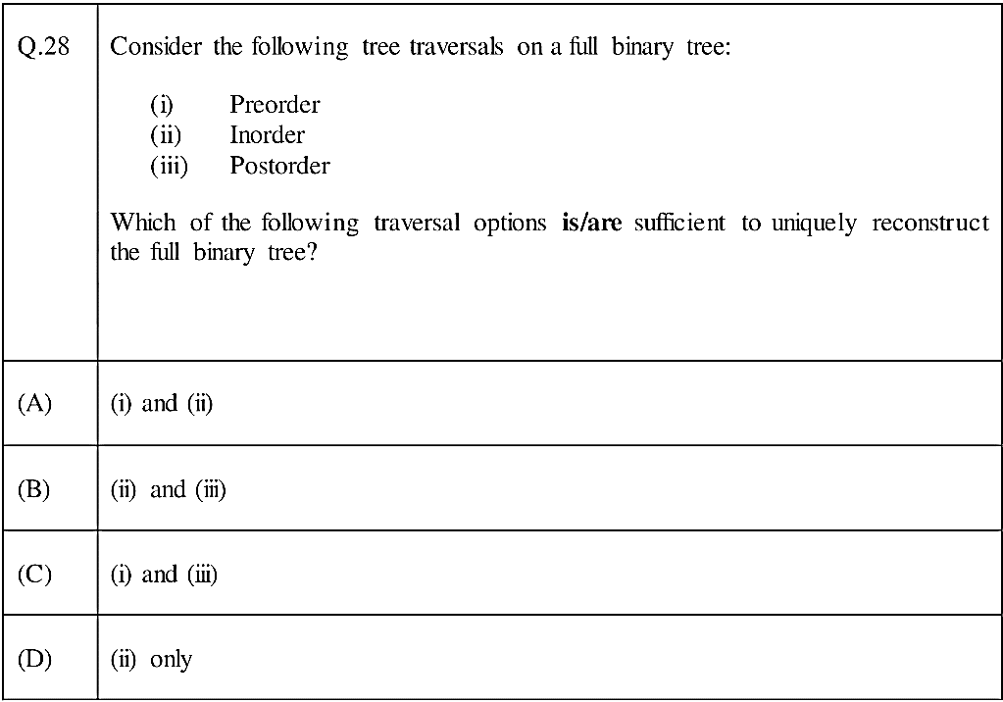
Gate DA -2024

Slide 29
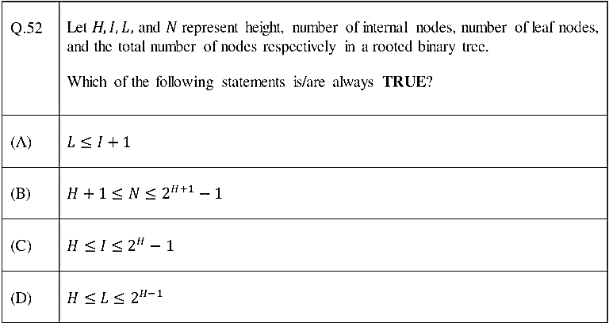
Gate DA -2024

Slide 30
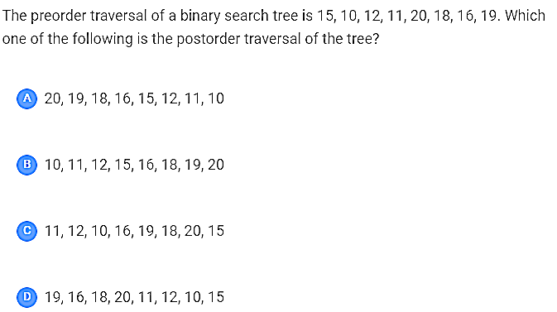
GATE CSE 2020

Slide 31
GATE CSE 2018
The postorder traversal of a binary tree is 8, 9, 6, 7, 4, 5, 2, 3, 1. The inorder traversal of the same tree is 8, 6, 9, 4, 7, 2, 5, 1, 3. The height of a tree is the length of the longest path from the root to any leaf. The height of the binary tree above is_____________

Slide 32
Hashing

Slide 33
Hash Tables
We’ll discuss the hash table ADT which supports only a subset of the operations allowed by binary search trees.
The implementation of hash tables is called hashing.
Hashing is a technique used for performing insertions, deletions and finds in constant average time (i.e. O(1))
This data structure, however, is not efficient in operations that require any ordering information among the elements, such as findMin, findMax and printing the entire table in sorted order.

Slide 34
Example
Hash
Table
0
1
Items
Hash
Function
2
john 25000
3
john 25000
phil 31250
key
4
phil 31250
dave 27500
5
mary 28200
6
dave 27500
7
mary 28200
key
8
9

Slide 35
Hash Function
The hash function:
must be simple to compute.
must distribute the keys evenly among the cells.
If we know which keys will occur in advance we can write perfect hash functions, but we don’t.

Slide 36
Hash function
Problems:
Keys may not be numeric.
Number of possible keys is much larger than the space available in table.
Different keys may map into same location
Hash function is not one-to-one => collision.
If there are too many collisions, the performance of the hash table will suffer dramatically.

Slide 37
Hash Functions
If the input keys are integers then simply Key mod TableSize is a general strategy.
Unless key happens to have some undesirable properties. (e.g. all keys end in 0 and we use mod 10)
If the keys are strings, hash function needs more care.
First convert it into a numeric value.

Slide 38
Some methods
Truncation:
e.g. 123456789 map to a table of 1000 addresses by picking 3 digits of the key.
Folding:
e.g. 123|456|789: add them and take mod.
Key mod N:
N is the size of the table, better if it is prime.
Squaring:
Square the key and then truncate
Radix conversion:
e.g. 1 2 3 4 treat it to be base 11, truncate if necessary.

Slide 39
Hash function for strings:
99
108
105
key[i]
key
d
l
i
2 1 0
i
KeySize = 3;
hash(“bli”) = (99*37² + 108*37 + 105 * 1) % 10,007 = 8173
0
hash function
1
2
“bli”
……
bli
8173
……
10,006 (TableSize)

Slide 40
Operations
Initialization: all entries are set to NULL
Find:
locate the cell using hash function.
sequential search on the linked list in that cell.
Insertion:
Locate the cell using hash function.
(If the item does not exist) insert it as the first item in the list.
Deletion:
Locate the cell using hash function.
Delete the item from the linked list.

Slide 41
Collision Resolution
If, when an element is inserted, it hashes to the same value as an already inserted element, then we have a collision and need to resolve it.
There are several methods for dealing with this:
Open addressing
Linear Probing
Quadratic Probing
Double Hashing
Separate chaining

Slide 42
Collision Resolution with Open Addressing
Separate chaining has the disadvantage of using linked lists.
Requires the implementation of a second data structure.
In an open addressing hashing system, all the data go inside the table.
Thus, a bigger table is needed.
Generally the load factor should be below 0.5.
If a collision occurs, alternative cells are tried until an empty cell is found.

Slide 43
Open Addressing
More formally:
Cells h₀(x), h₁(x), h₂(x), …are tried in succession
where h_{i}(x) = (hash(x) + f(i)) mod TableSize, with f(0) = 0.
The function f is the collision resolution strategy.
There are three common collision resolution strategies:
Linear Probing
Quadratic probing
Double hashing

Slide 44
Linear Probing
In linear probing, collisions are resolved by sequentially scanning an array (with wraparound) until an empty cell is found.
i.e. f is a linear function of i, typically f(i)= i.
Example:
Insert items with keys: 89, 18, 49, 58, 9 into an empty hash table.
Table size is 10.
Hash function is hash(x) = x mod 10.
f(i) = i;

Slide 45
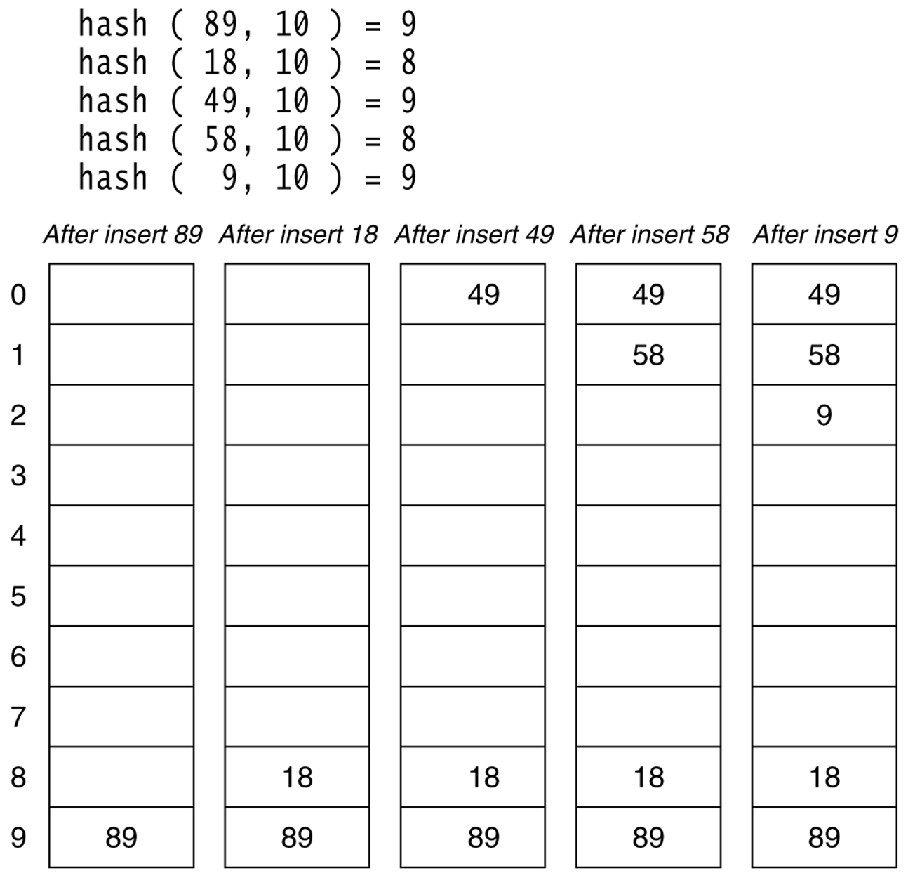
Linear probing hash table after each insertion

Slide 46
Find and Delete
The find algorithm follows the same probe sequence as the insert algorithm.
A find for 58 would involve 4 probes.
A find for 19 would involve 5 probes.
We must use lazy deletion (i.e. marking items as deleted)
Standard deletion (i.e. physically removing the item) cannot be performed.

Slide 47
Linear Probing – Analysis -- Example
What is the average number of probes for a successful search and an unsuccessful search for this hash table?
Hash Function: h(x) = x mod 11
Successful Search:
20: 9 -- 30: 8 -- 2 : 2 -- 13: 2, 3 -- 25: 3,4
24: 2,3,4,5 -- 10: 10 -- 9: 9,10, 0
Avg. Probe for SS = (1+1+1+2+2+4+1+3)/8=15/8
Unsuccessful Search:
We assume that the hash function uniformly distributes the keys.
0: 0,1 -- 1: 1 -- 2: 2,3,4,5,6 -- 3: 3,4,5,6
4: 4,5,6 -- 5: 5,6 -- 6: 6 -- 7: 7 -- 8: 8,9,10,0,1
9: 9,10,0,1 -- 10: 10,0,1
Avg. Probe for US =
(2+1+5+4+3+2+1+1+5+4+3)/11=31/11
0 | 9
1
2 | 2
3 | 13
4 | 25
5 | 24
6
7
8 | 30
9 | 20
10 | 10

Slide 48
Quadratic Probing
Quadratic Probing eliminates primary clustering problem of linear probing.
Collision function is quadratic.
The popular choice is f(i) = i².
If the hash function evaluates to h and a search in cell h is inconclusive, we try cells h + 1², h+2², … h + i².
i.e. It examines cells 1,4,9 and so on away from the original probe.
Remember that subsequent probe points are a quadratic number of positions from the original probe point.

Slide 49
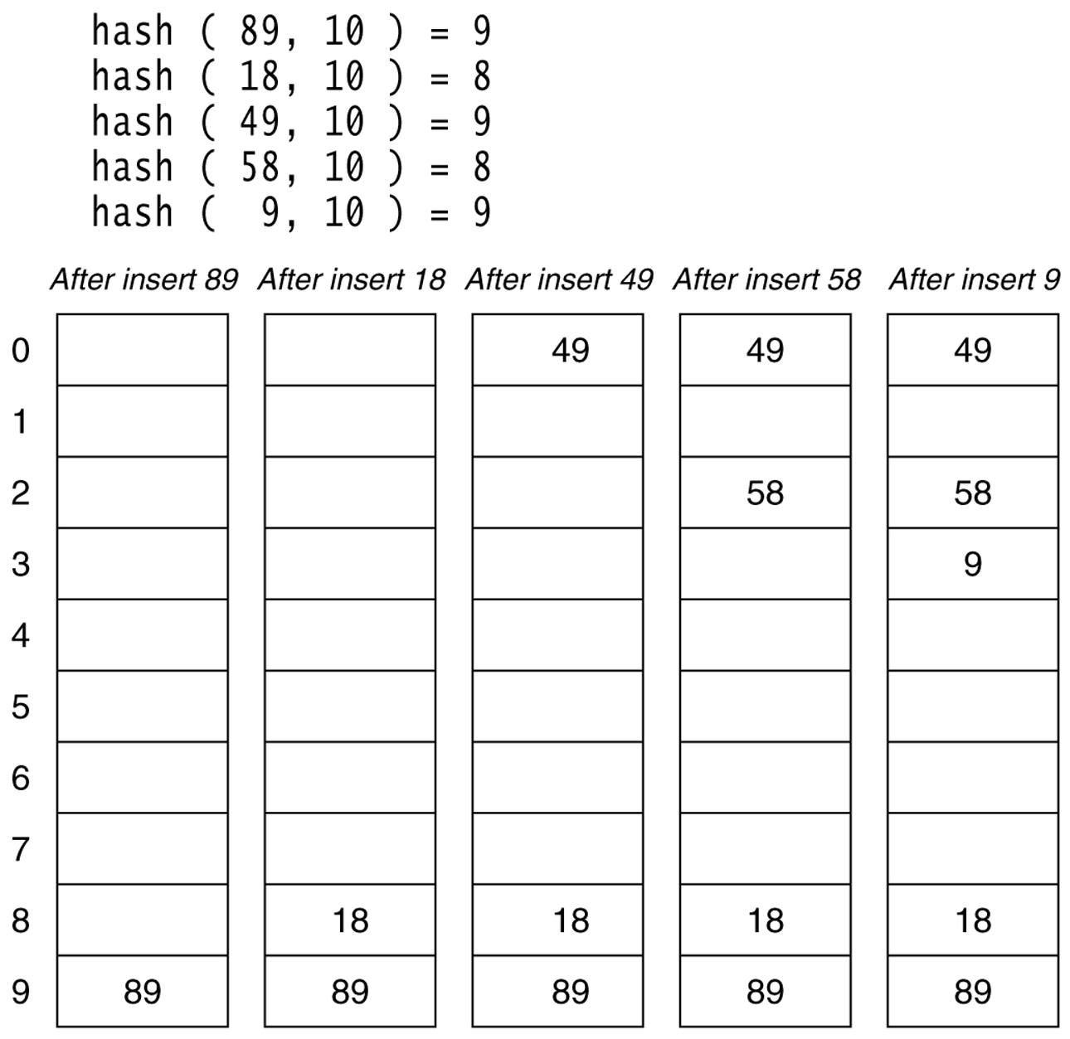
Figure 20.6
A quadratic probing hash table after each insertion (note that the table size was poorly chosen because it is not a prime number).

Slide 50
Quadratic Probing
Problem:
We may not be sure that we will probe all locations in the table (i.e. there is no guarantee to find an empty cell if table is more than half full.)
If the hash table size is not prime this problem will be much severe.
However, there is a theorem stating that:
If the table size is prime and load factor is not larger than 0.5, all probes will be to different locations and an item can always be inserted.

Slide 51
Some considerations
How efficient is calculating the quadratic probes?
Linear probing is easily implemented. Quadratic probing appears to require * and % operations.
However by the use of the following trick, this is overcome:
H_{i} = H_{i-1}+2i – 1 (mod M)

Slide 52
Some Considerations
What happens if load factor gets too high?
Dynamically expand the table as soon as the load factor reaches 0.5, which is called rehashing.
Always double to a prime number.
When expanding the hash table, reinsert the new table by using the new hash function.

Slide 53
Analysis of Quadratic Probing
Quadratic probing has not yet been mathematically analyzed.
Although quadratic probing eliminates primary clustering, elements that hash to the same location will probe the same alternative cells. This is know as secondary clustering.
Techniques that eliminate secondary clustering are available.
the most popular is double hashing.

Slide 54
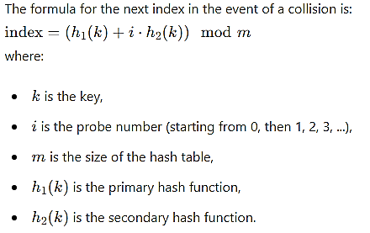
Double Hashing
Double hashing uses a secondary hash function to calculate the step size for probing. Here’s the general approach:
Primary Hash Function: The primary hash function h1(k) determines the initial position in the hash table.
Secondary Hash Function: The secondary hash function h2(k) determines the step size for probing.

Slide 55
Important Considerations
Choice of Secondary Hash Function: The secondary hash function h2(k) must be chosen carefully to ensure it is not zero and does not have common factors with the size of the hash table mmm. A common choice is h2(k)=q−(k mod q), where q is a prime number smaller than m.
Avoiding Clustering: Double hashing significantly reduces primary clustering (where clusters of filled slots build up) and secondary clustering (where sequences of probes are identical for different keys) compared to linear and quadratic probing.

Slide 56
Example
Suppose we have a hash table of size 11, and we use the following hash functions:
Primary hash function: h1(k)=k mod 11
Secondary hash function: h2(k)=7−(k mod 7)
For a key k=10:
Calculate the initial position: h1(10)=10 mod 11 =10.
If position 10 is occupied, calculate the step size: h2(10)=7−(10 mod 7)=7−3=4
Probe the next index: (10+1⋅4)mod 11=3
If position 3 is also occupied, continue probing: (10+2⋅4)mod 11=7

Slide 57
Separate Chaining
The idea is to keep a list of all elements that hash to the same value.
The array elements are pointers to the first nodes of the lists.
A new item is inserted to the front of the list.
Advantages:
Better space utilization for large items.
Simple collision handling: searching linked list.
Overflow: we can store more items than the hash table size.
Deletion is quick and easy: deletion from the linked list.

Slide 58
Example
Keys: 0, 1, 4, 9, 16, 25, 36, 49, 64, 81
hash(key) = key % 10.
0
0
1
81
1
2
3
4
64
4
5
25
6
36
16
7
8
9
49
9

Slide 59
Analysis of Separate Chaining
Collisions are very likely.
How likely and what is the average length of lists?
Load factor λ definition:
Ratio of number of elements (N) in a hash table to the hash TableSize.
i.e. λ = N/TableSize
The average length of a list is also λ.
For chaining λ is not bound by 1; it can be > 1.

Slide 60
Cost of searching
Cost = Constant time to evaluate the hash function + time to traverse the list.
Unsuccessful search:
We have to traverse the entire list, so we need to compare λ nodes on the average.
Successful search:
List contains the one node that stores the searched item + 0 or more other nodes.
Expected # of other nodes = x = (N-1)/M which is essentially λ, since M is presumed large.
On the average, we need to check half of the other nodes while searching for a certain element
Thus average search cost = 1 + λ/2

Slide 61
Summary
The analysis shows us that the table size is not really important, but the load factor is.
TableSize should be as large as the number of expected elements in the hash table.
To keep load factor around 1.
TableSize should be prime for even distribution of keys to hash table cells.

Slide 62
Hashing Applications
Compilers use hash tables to implement the symbol table (a data structure to keep track of declared variables).
Game programs use hash tables to keep track of positions it has encountered (transposition table)
Online spelling checkers.

Slide 63
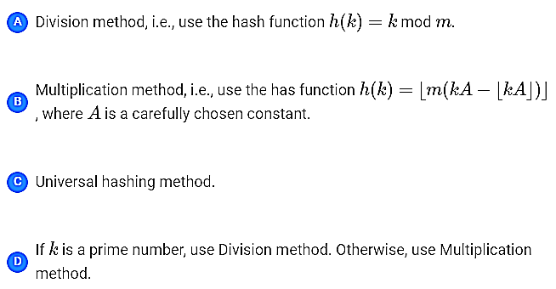
GATE CSE 2023
An algorithm has to store several keys generated by an adversary in a hash table. The adversary is malicious who tries to maximize the number of collisions. Let 𝑘 be the number of keys, 𝑚 be the number of slots in the hash table, and 𝑘>𝑚. Which one of the following is the best hashing strategy to counteract the adversary?

Slide 64
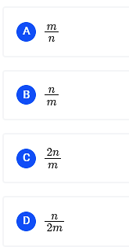
GATE CSE 2022
Suppose we are given n keys, m has table slots, and two simple uniform hash functions h₁ and h₂. Further suppose our hashing scheme uses h₁ for the odd keys and h₂ for the even keys. What is the expected number of keys in a slot?

Slide 65
GATE CSE 2020
Consider a double hashing scheme in which the primary hash function is h₁(k)=k mod 23, and the secondary hash function is h₂(k)=1+(k mod 19). Assume that the table size is 23. Then the address returned by probe 1 in the probe sequence (assume that the probe sequence begins at probe 0) for key value k=90 is _______.

Slide 66
GATE CSE 2015 Set 3
Given a hash table 𝑇 with 25 slots that stores 2000 elements, the load factor 𝛼 for 𝑇 is ____________ .

Slide 67
GATE CSE 2007
Consider the following two statements:
A hash function (these are often used for computing digital signatures) is an injective function.
Encryption technique such as DES performs a permutation on the elements of its input alphabet. Which one of the following options is valid for the above two statements?

Slide 68
GATE CSE 2005
A hash table contains 10 buckets and uses linear probing to resolve collisions. The key values are integers and the hash function used is key % 10.
If the values 43, 165, 62, 123, 142 are inserted in the table, in what location would the key value 142 be inserted?

Slide 69
GATE CSE 2004,
Given the following input (4322, 1334, 1471, 9679, 1989, 6171, 6173, 4199) and the hash function x mod 10, which of the following statements are true?
9679, 1989, 4199 hash to the same value
1471, 6171 has to the same value
All elements hash to the same value
Each element hashes to a different value

